Slide 1
Religious Freedoms
By: Taylor, Brandi, Jason, Matt, Justin, Miranda, Merissa, and Kassidy

Slide 2
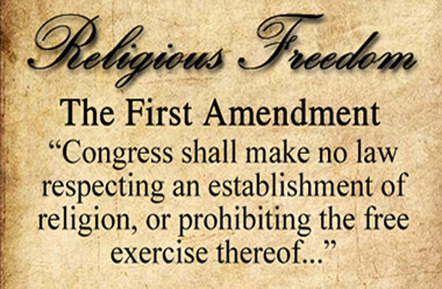
How does the 1st Amendment guarantee religious freedom?
It forbids the government from establishing an official religion, it also guarantees religious freedoms by guaranteeing people's rights to a free exercise of their own religion

Slide 3
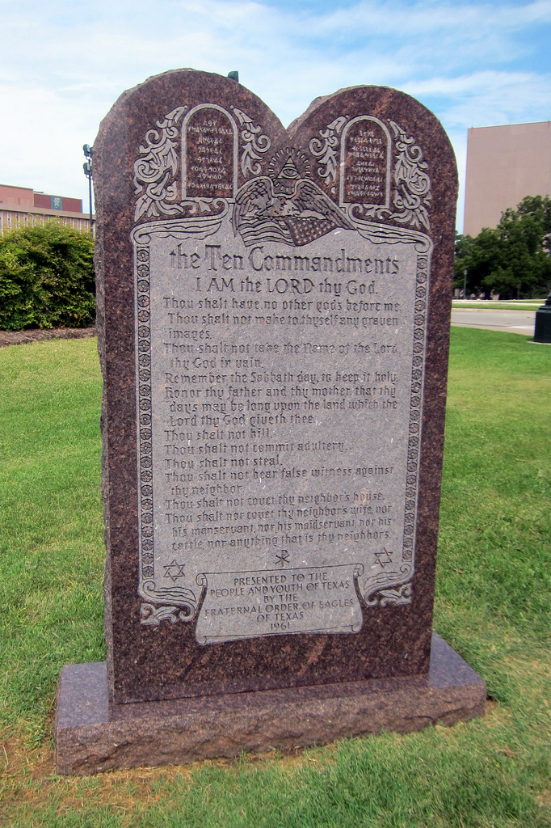
How did the Supreme Court’s ruling in McCreary County contrast from its ruling in Van Orden?
Van order allowed courts to have Ten Commandments to be displayed at the Texas states capitol, but McCreary counties didn't outlaw it because it was an unconstitutional government permission of a certain beliefs

Slide 4
Why were so many colonists concerned about religious freedom?
Because many of them came to the colony's for the freedom of practice their faith without discrimination they faced in their home countries

Slide 5
What questions does the Lemon Test ask of a law?
It must haves secular or nonreligious purposes its major effects must neither advance nor inhibit religion and must not encountered “ exercise government entanglement with religion

Slide 6
Why do you think that the application of the establishment clause in education has been so strongly debated?
Because many people begin to question their beliefs or refuse to do work on a topic that is different from their religion

Slide 7
What is the free exercise clause?
It guarantees each person to hold any religious beliefs they choose

Slide 8
What does the Barnette decision reveal about the Supreme Court?
They decided that the state's interest in national unity was not strong enough to force people to act upon their beliefs

Slide 9
Is it legal for an American citizen to hold religious beliefs that promote illegal drug use as a form of worship?
No

